Slide 1
CS 321-Analysis of Algorithms
Lecture 06
Instructor: Asim Rehan
arehan@numl.edu.pk
National University of Modern Languages, Islamabad

Slide 2
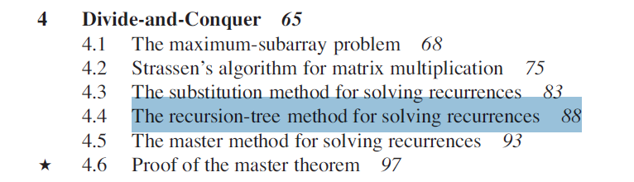
Recursion-Tree Method to Solve Recurrence Relations
Chapter No 4 of Book “ Introduction to Algorithm 3rd Edition”
Notes:
We compute the time complexity of Recursive algorithm by making their recurrence relations then we can solve the recurrence relation by:
Substitution Method
Iteration Method
Recursion Tree Method
Master’s Theorm

Slide 3
Recursion-tree method
A recursion tree models the costs (time) of a recursive execution of an algorithm.
Recursion Tree Method is a pictorial representation of an iteration method which is in the form of a tree where at each level nodes are expanded
A recursion tree is a tree where each node represents the cost of a certain recursive sub-problem.
It is useful when the divide & Conquer algorithm is used.
Notes:
It is useful when the problem is Dividing in to sub-problems . Like t(n/2) t(n/3)…. It will not useful for T(n-1) because problem is not dividing into sub-problems.

Slide 4
Recursion-tree method
Convert the recurrence into a tree:
Each node represents the cost calculated at various levels of recursion
Sum up the costs of all levels

Slide 5
Recursion Tree for Merge Sort
T(n) = 2T (n/2) + n.
n
T(n/2)
T(n/2)
cn
n/2
n/2
T(n/4)
T(n/4)
T(n/4)
T(n/4)
Notes:
This is the recurrence tree of Merge Sort and the relation was 2t(n/2) + n.

Slide 6
Recursion Tree for Merge Sort
cn
cn/2
cn/2
T(n/4)
T(n/4)
T(n/4)
T(n/4)
Eventually, the input size (the argument of T) goes to 1, so...
Notes:
We will continue expanding the tree till we meet the base case when the size of problem is 1.

Slide 7
Recursion Tree for Merge Sort
cn
cn/2
cn/2
T(n/4)
T(n/4)
T(n/4)
T(n/4)
T(1)
T(1)
T(1)
T(1)
.............................
T(1)
T(1)
n sub problems of size 1, but T(1) = c by boundary condition

Slide 8
Recursion Tree for Merge Sort
cn
cn/2
cn/2
T(n/4)
T(n/4)
T(n/4)
T(n/4)
c
c
c
c
.............................
c
c
n subproblems of size 1

Slide 9
Key Notes:
Determine:
Cost of each level
Height of Tree
Nodes per level
Sum up the costs of all levels to get the time complexity:
If the cost of each level is same then multiply height of tree with cost per level to get the complexity.
If the cost of each level is different then we have to perform some mathematics and we will find some series.

Slide 10
Recursion Tree for Merge Sort
level nodes/ cost/
level level
0 2⁰ = 1 cn
1 2¹ = 2 cn
2 2² = 4 cn
. .
. .
. .
N-1 2^{N-1}=n cn
Since 2^{N-1} = n, lg(2^{N-1}) = lg(n)
levels = N = 1+lg(n)
T(n) = total cost = (levels)(cost/level)
T(n) = cn [1+lg(n)] = O( n lg(n))
n nodes at level N-1

Slide 11
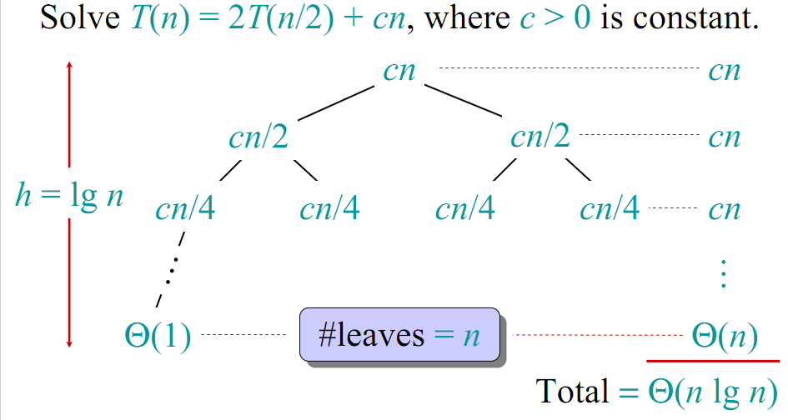
Visual Representation of the Recurrence for Merge Sort
Subproblem size at level i is: n/2^{i}
Subproblem size hits 1 when 1 = n/2^{i} ⇒ i = log₂n

Slide 12
Example of recursion tree
Solve T(n) = T(n/4) + T(n/2) + n²:

Slide 13
Example of recursion tree
Solve T(n) = T(n/4) + T(n/2) + n²:
T(n)

Slide 14
Example of recursion tree
Solve T(n) = T(n/4) + T(n/2) + n²:
n²
T(n/4)
T(n/2)

Slide 15
Example of recursion tree
Solve T(n) = T(n/4) + T(n/2) + n²:
n²
(n/4)²
(n/2)²
T(n/16)
T(n/8)
T(n/8)
T(n/4)

Slide 16
Example of recursion tree
Solve T(n) = T(n/4) + T(n/2) + n²:
n²
(n/4)²
(n/2)²
(n/16)²
(n/8)²
(n/8)²
(n/4)²
…
Θ(1)

Slide 17
Example of recursion tree
Solve T(n) = T(n/4) + T(n/2) + n²:
n²
(n/4)²
(n/2)²
(n/16)²
(n/8)²
(n/8)²
(n/4)²
…
Θ(1)

Slide 18
Example of recursion tree
Solve T(n) = T(n/4) + T(n/2) + n²:
n²
(n/4)²
(n/2)²
(n/16)²
(n/8)²
(n/8)²
(n/4)²
…
Θ(1)

Slide 19
Example of recursion tree
Solve T(n) = T(n/4) + T(n/2) + n²:
n²
(n/4)²
(n/2)²
(n/16)²
(n/8)²
(n/8)²
(n/4)²
…
…
Θ(1)

Slide 20
Example of recursion tree
Solve T(n) = T(n/4) + T(n/2) + n²:
n²
(n/4)²
(n/2)²
(n/16)²
(n/8)²
(n/8)²
(n/4)²
…
…
Θ(1)
Total =
= Θ(n²)
geometric series
Notes:
In mathematics, a geometric series is a series with a constant ratio between successive terms. For example, the series
5/16
is geometric, because each successive term can be obtained by multiplying the previous term by 5/16.
5/16 is the common trem.

Slide 21
Appendix: geometric series
for x ≠ 1
for |x| < 1
Return to last slide viewed.

Slide 22
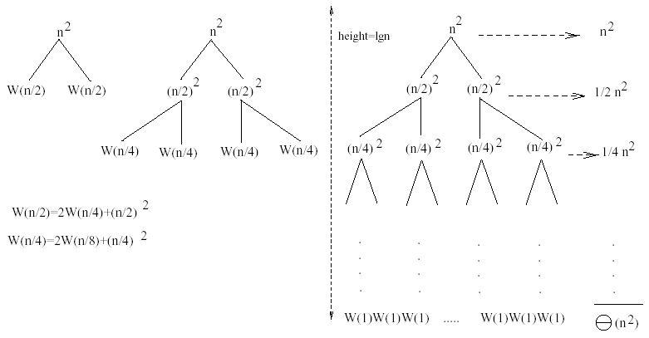
Example 3
W(n) = 2W(n/2) + n²
Subproblem size at level i is: n/2^{i}
Subproblem size hits 1 when 1 = n/2^{i} ⇒ i = lgn
Cost of the problem at level i = (n/2^{i})² No. of nodes at level i = 2^{i}
Total cost:
⇒ W(n) = O(n²)

Slide 23
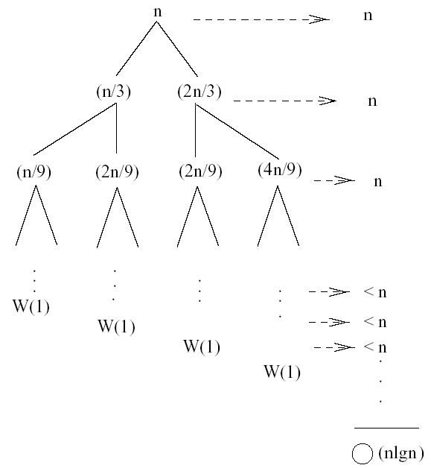
Example 4 (simpler proof)
W(n) = W(n/3) + W(2n/3) + n
The longest path from the root to a leaf is: n → (2/3)n → (2/3)² n → … → 1
Subproblem size hits 1 when 1 = (2/3)^{i}n ⇔ i=log_{3/2}n
Cost of the problem at level i = n
Total cost:
⇒ W(n) = O(nlgn)

Slide 24
Practice Problems.
Solved all the given examples by yourself on a paper.
T(n) = 3T(n/4) + cn²

Slide 26
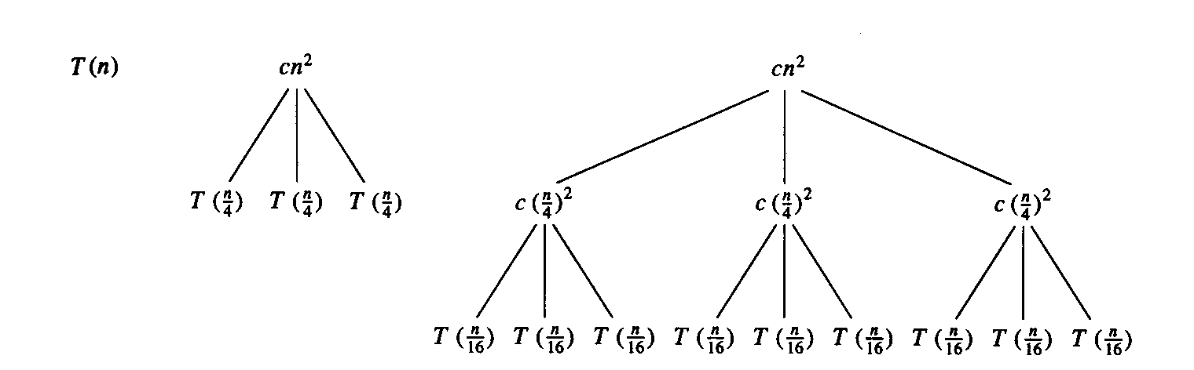
Example 4
E.g.: T(n) = 3T(n/4) + cn²
Subproblem size at level i is: n/4^{i}
Subproblem size hits 1 when 1 = n/4^{i} ⇒ i = log₄n
Cost of a node at level i = c(n/4^{i})²
Number of nodes at level i = 3^{i} ⇒ last level has 3^{log}₄^{n} = n^{log}₄³ nodes
Total cost:
⇒ T(n) = O(n²)

